Slide 1

Natural Disasters
Data
Analysis

Slide 2

Understanding the Human and Economic loss using Python Data Analysis
Natural disasters affect both human lives and economies.
But which disasters are the most-deadly?
And which ones cause the most financial damage?

Slide 3
Information of the Data Set
Disaster ID – Integer
Disaster_Type – String
Location – String
Magnitude – Float
Date – Float
Fatalities – Float
Economic Loss in Million dollars – Integer
Buildings Collapsed – Float
Probability – Float

Slide 4
Data Preparation
&
Data
Cleaning
Loaded the data set into Jupyter notebook using Pandas Library
Identified the null value columns and dropped them from our analysis
Selected the relevant Columns (Like., Disaster Type, Fatalities, Economic Loss)
We focused our analysis on Fatalities and Economic Losses

Slide 5

What are the Libraries we used to explore the data?
Pandas
Matloplotlib
Scikit

Slide 6
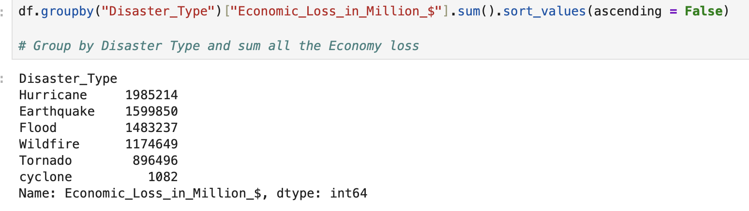
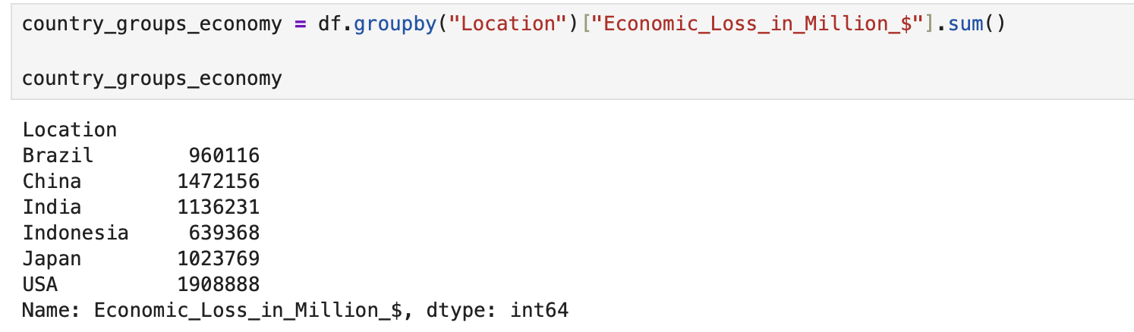
Total Economic Loss by Disaster Type, Country

Slide 7
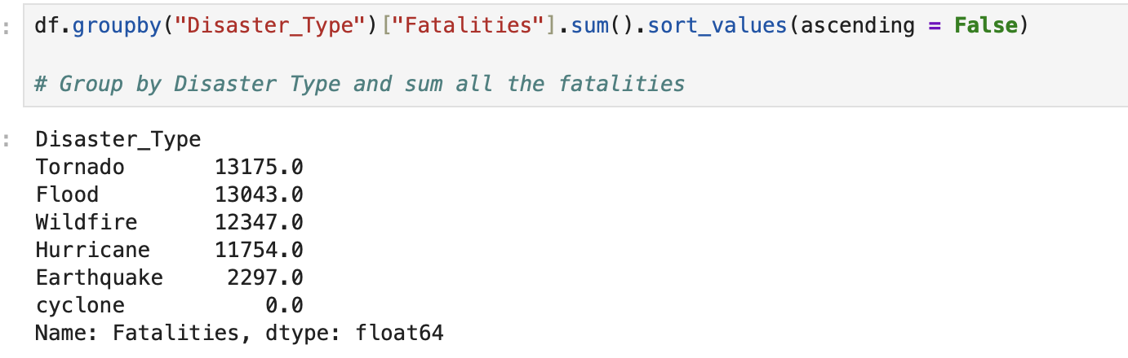
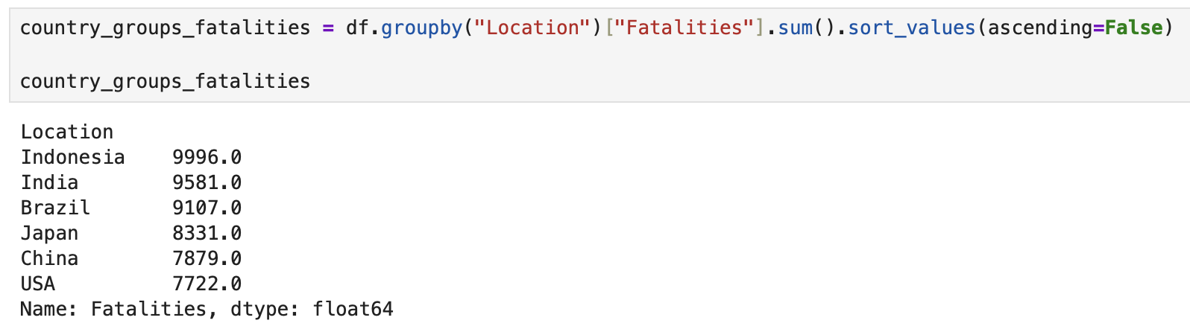
Total Fatalities by Disaster Type, Country

Slide 8
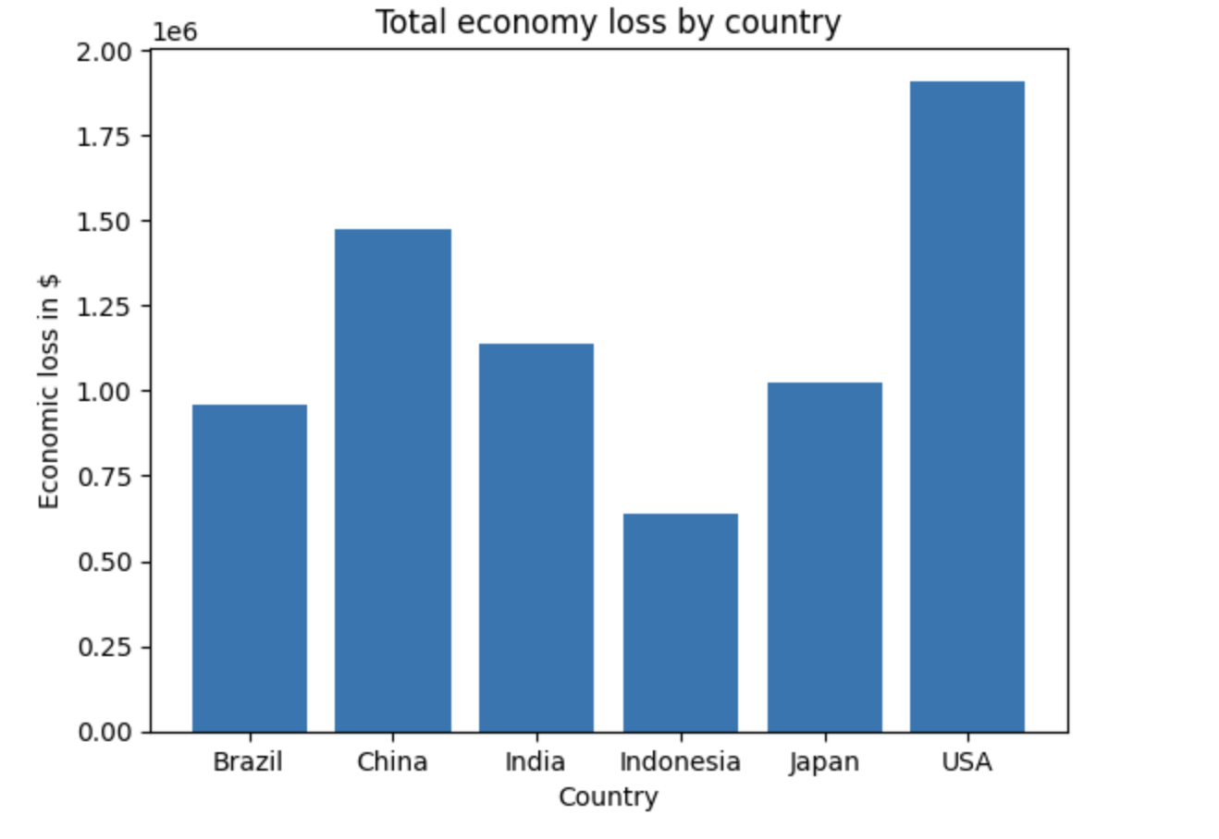
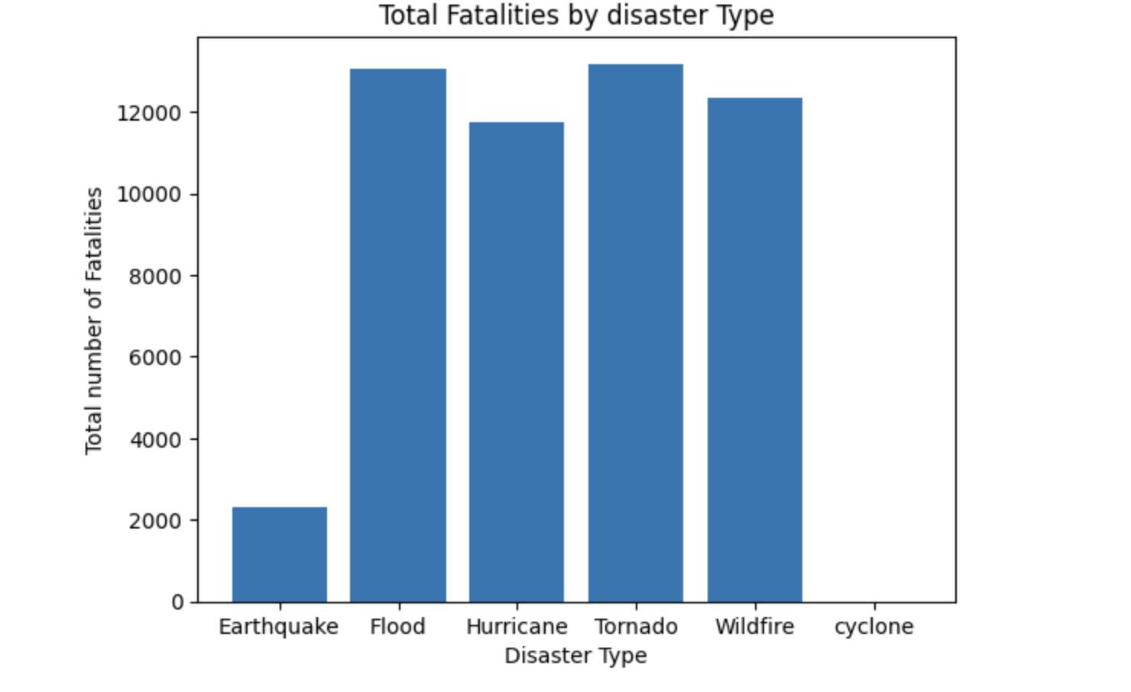
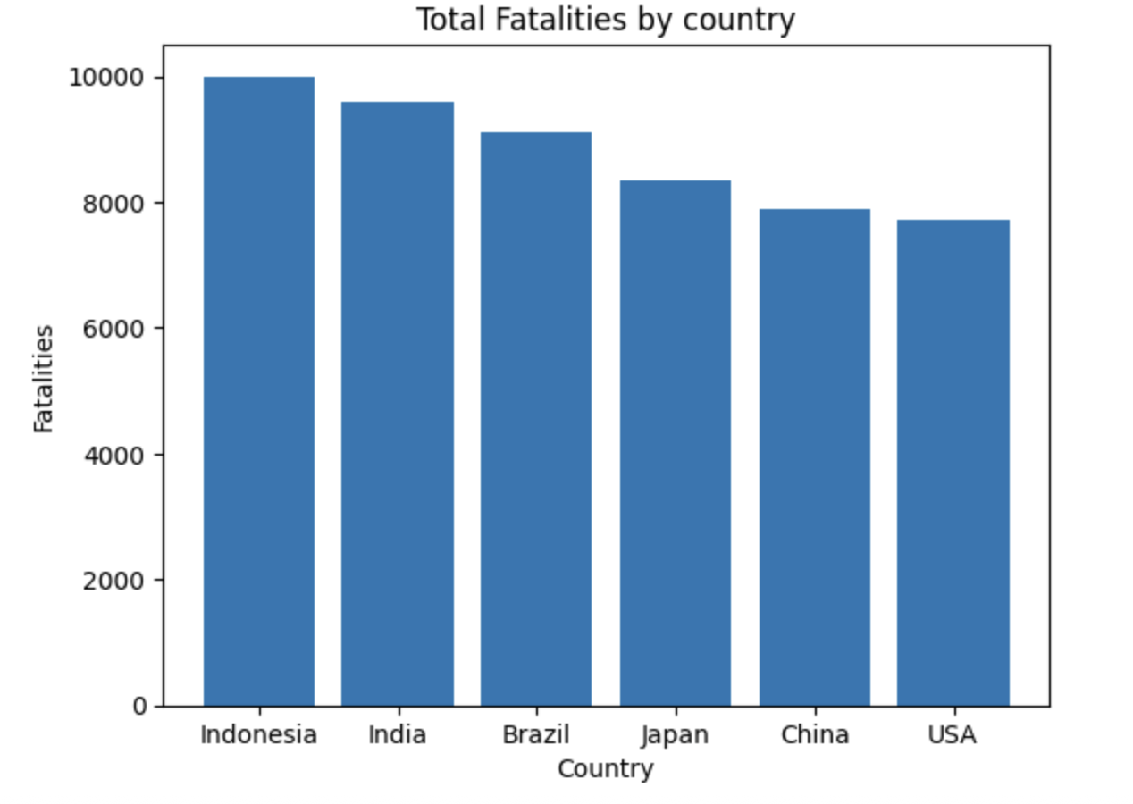
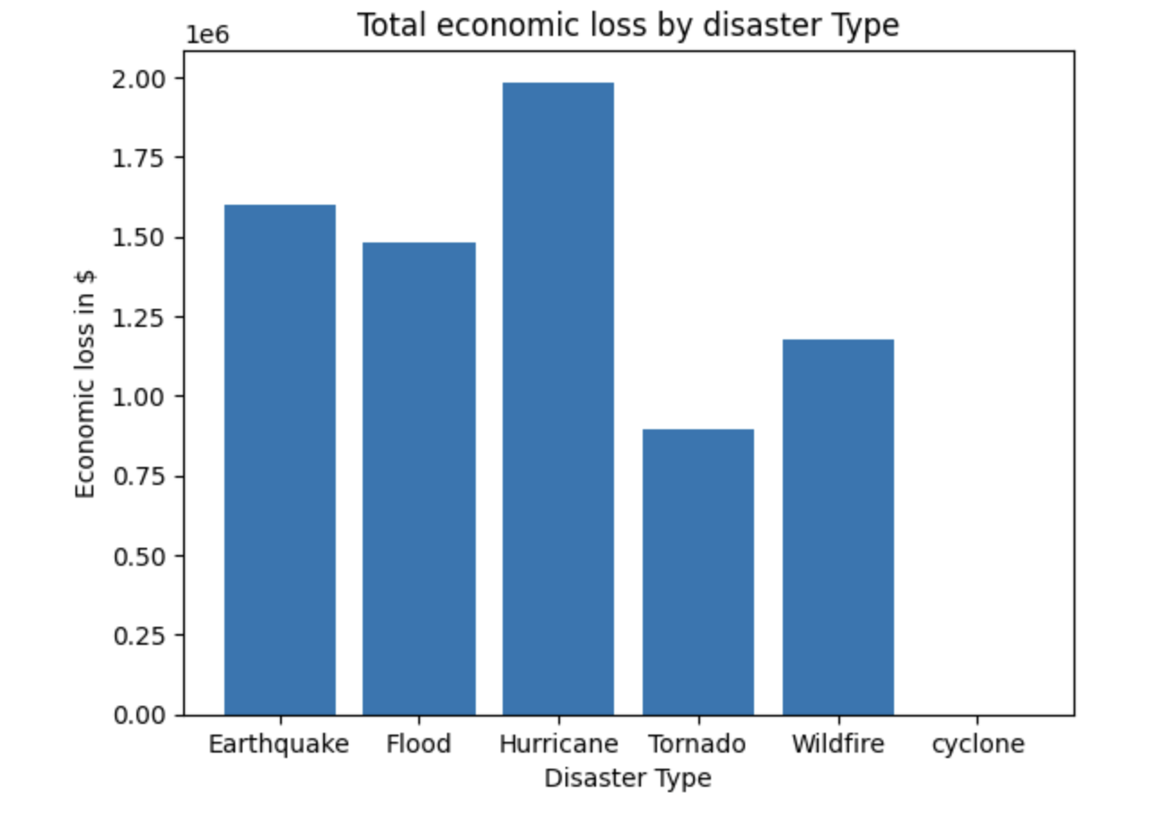
Graphical Presentation

Slide 9
Training a Model using Linear Regression
Features : ["Disaster_Type","Location","Magnitude",”Fatalities"]]
Label : [“Economic_Loss_in_Million_$”]
Encoded Features : ["Disaster_Type","Location"]

Slide 10
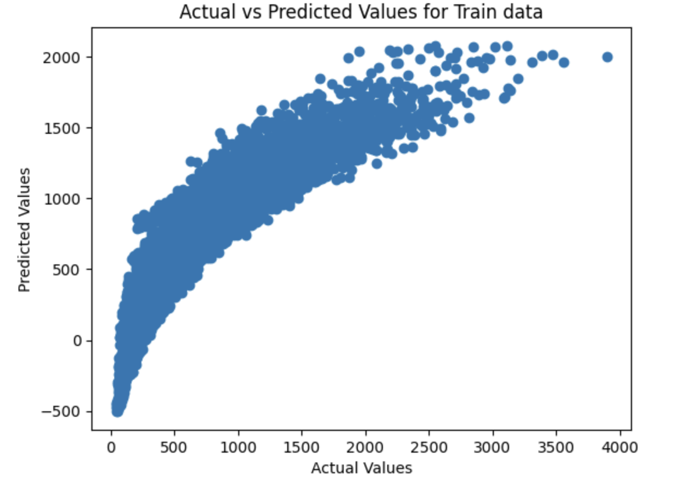
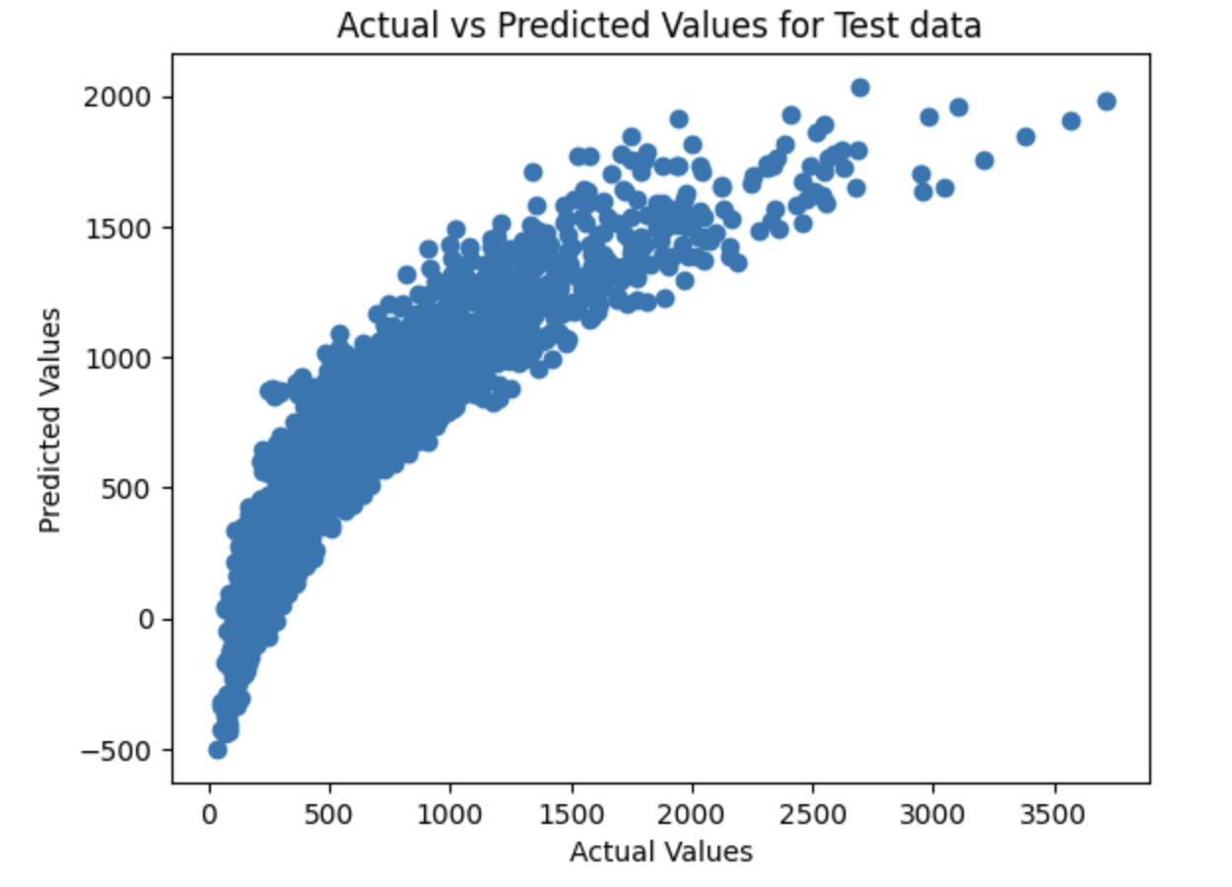
Final Conclusions

